Slide 1
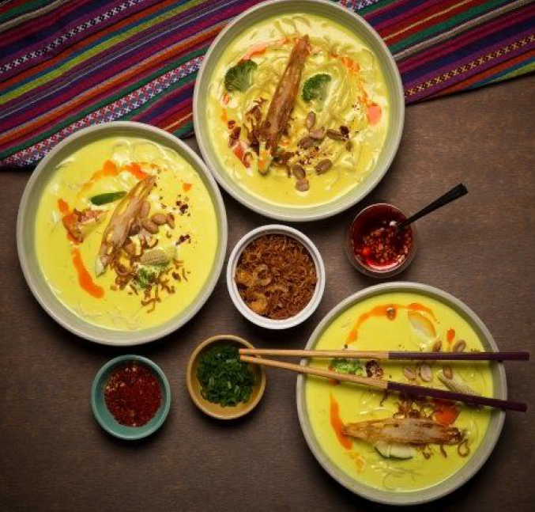
Coursera IBM Data Science Capstone Project : Opening a new Bermese Restaurant in Toronto
Report Prepared by :
Abhishek Baidya

Slide 2
Introduction
For this Capstone project, I am creating a hypothetical scenario for a concept Burmese restaurateur who wants to explore opening an authentic Burmese restaurant in Toronto area.
The idea behind this project is that there may not be enough Burmese restaurants in Toronto and it might present a great opportunity for this entrepreneur who is based in Canada. As Burmese food is very similar to other Asian cuisines, this entrepreneur is thinking of opening this restaurant in locations where Asian food is popular (aka many Asian restaurants in the neighborhood).

Slide 3
Business Problem
The objective of this capstone project is to find the most suitable location for the entrepreneur to open a new Burmese restaurant in Toronto, Canada. By using data science methods and machine learning methods such as clustering, this project aims to provide solutions to answer the business question:
In Toronto, if an entrepreneur wants to open a Burmese restaurant,where should they consider opening it?
Target Audience:
The entrepreneur who wants to find the location to open authentic Burmese restaurant

Slide 4
Data
To solve this problem, I will need below data:
List of neighborhoods in Toronto, Canada.
Latitude and Longitude of these neighborhoods for Location.
Venue data related to Asian restaurants. This will help us find the neighborhoods that are most suitable to open a Burmese restaurant.

Slide 5
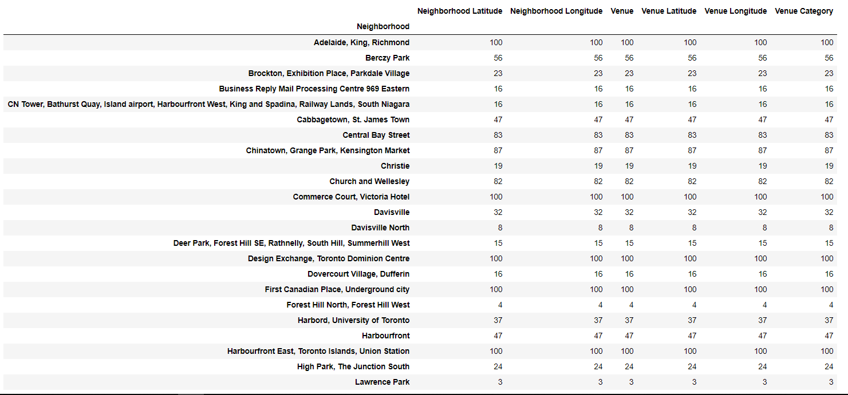
Extracting Data
Scrapping of Toronto neighborhoods via Wikipedia
Getting Latitude and Longitude data of these neighborhoods via Geocoder package
Using Foursquare API to get venue data related to these neighborhoods

Slide 6
Methodology
First, I need to get the list of neighborhoods in Toronto, Canada. This is possible by extracting the list of neighborhoods from Wikipedia page (“ https://en.wikipedia.org/wiki/List_of_postal_codes_of_Canada:_M ”) I did the web scraping by utilizing pandas html table scraping method as it is easier and more
I will need to get their coordinates to utilize Foursquare to pull the list of venues near these neighborhoods. After gathering all these coordinates, I visualized the map of Toronto using Folium package to verify whether these are correct coordinates. Next, I use Foursquare API to pull the list of top 100 venues within 500 meters radius. From Foursquare, I am able to pull the names, categories, latitude and longitude of the venues. With this data, I can also check how many unique categories that I can get from these venues. Then, I analyze each neighborhood by grouping the rows by neighborhood and taking the mean on the frequency of occurrence of each venue category.
Previously, when I ran the model, I was looking for “Asian restaurants” but there are very few results (maybe due to Foursquare categorization) so I looked for the restaurants closest to Burmese cuisine taste (side note: Burmese food and Thai food are very similar in taste, so my justification is that if there are people who enjoyed Thai food, they likely are going to enjoy Burmese food too)
Lastly, I performed the clustering method by using k-means clustering. K-means clustering algorithm identifies k number of centeriods, and then allocates every data point to the nearest cluster, while keeping the centroids as small as possible. It is one of the simplest and popular unsupervised machine learning algorithms and it is highly suited for this project as well. I have clustered the neighborhoods in Toronto into 3 clusters based on their frequency of occurrence for “Thai food”. Based on the results (the concentration of clusters), I will be able to recommend the ideal location to open the restaurant.

Slide 7
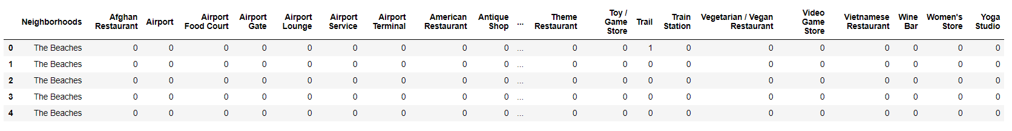
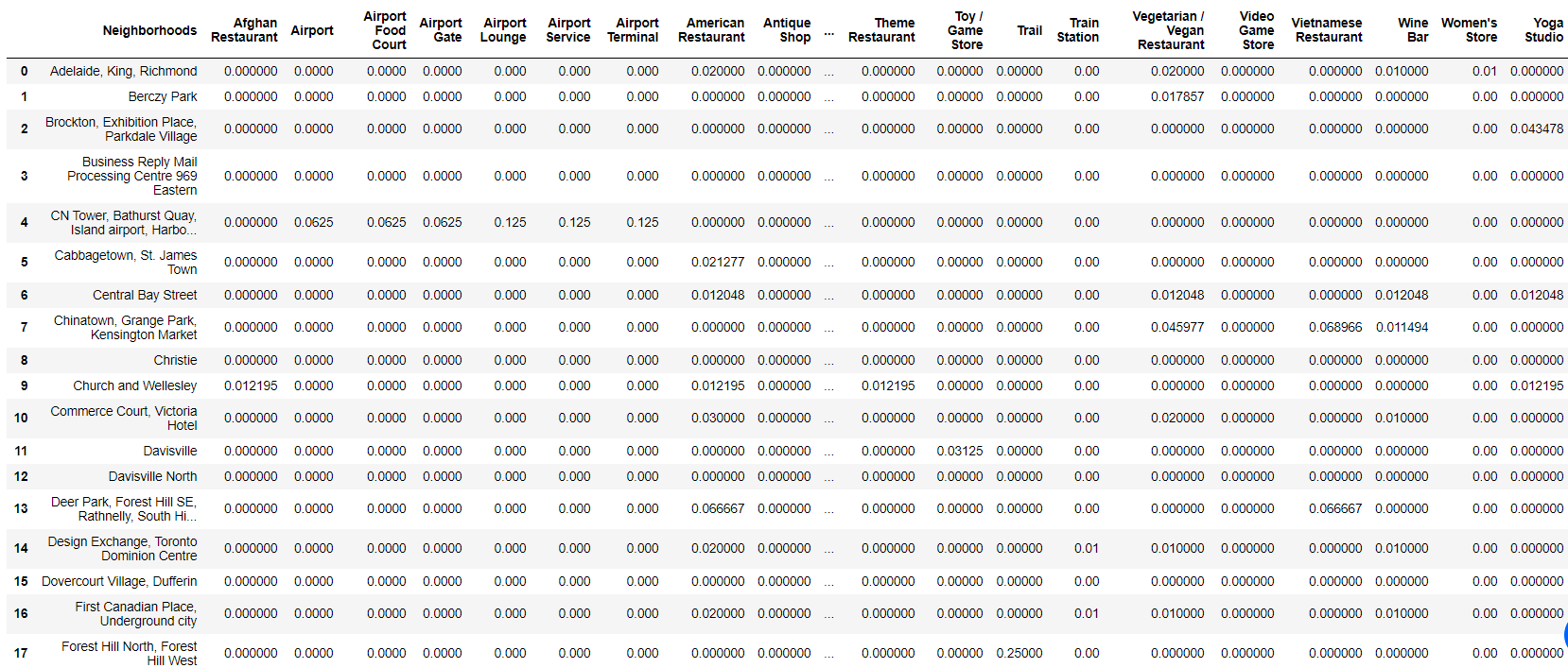
Results

Slide 8
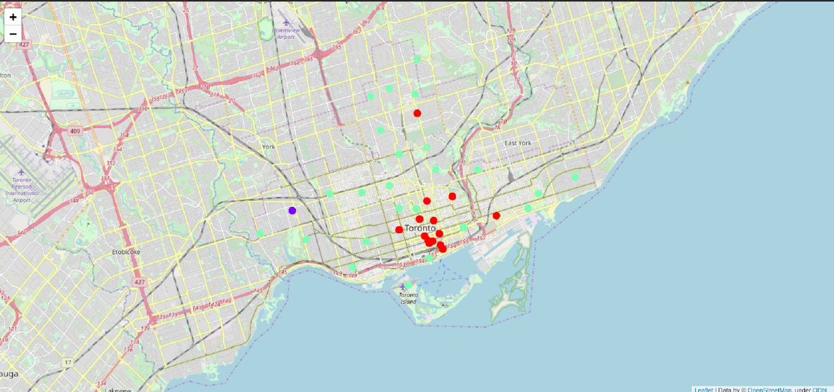
Clusters
The results from k-means clustering show that we can categorize Toronto neighborhoods into
3 clusters based on how many Thai restaurants are in each neighborhood:
Cluster 0: Neighborhoods with little or no Thai restaurants
Cluster 1: Neighborhoods with no Thai restaurants
Cluster 2: Neighborhoods with high number of Thai restaurants
The results are visualized in the above map with Cluster 0 in red color, Cluster 1 in purple
Color and Cluster 2 in light green color.

Slide 9
Recommendation
Most of Thai restaurants are in Cluster 2 which is around Adelaide, King, Richmond areas and lowest (close to zero) in Cluster 1 areas which are North Toronto West and Parkdale areas.
Also, there are good opportunities to open near Chinatown, St James town as the competition seems to be low. Looking at nearby venues, it seems Cluster 1 might be a good location as there are not a lot of Asian restaurants in these areas. Therefore, this project recommends the entrepreneur to open an authentic Burmese restaurant in these locations with little to no competition. Nonetheless, if the food is authentic, affordable and good taste, I am confident that it will have great following everywhere.

Slide 10
Conclusion
In this project, we have gone through the process of identifying the business problem, specifying the data required, extracting and preparing the data, performing the machine learning by utilizing k-means clustering and providing recommendation to the stakeholder.
References:
List of neighborhoods in Toronto:
https://en.wikipedia.org/wiki/List_of_postal_codes_of_Canada:_M
Foursquare Developer Documentation: https://developer.foursquare.com/docs

